Slide 1
Overview of Next Generation Short Read Sequencing Technologies
Elaine R. Mardis, Ph.D., FAACR
Co-Executive Director, The Steve and Cindy Rasmussen Institute for Genomic Medicine at Nationwide Children’s Hospital
The Steve and Cindy Rasmussen Nationwide Foundation Endowed Chair in Genomic Medicine
Professor of Pediatrics and Neurosurgery, The Ohio State University College of Medicine

Slide 2
Next Generation Sequencing Basics
How massively parallel sequencing works

Slide 3
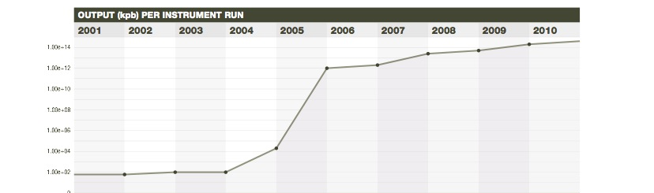
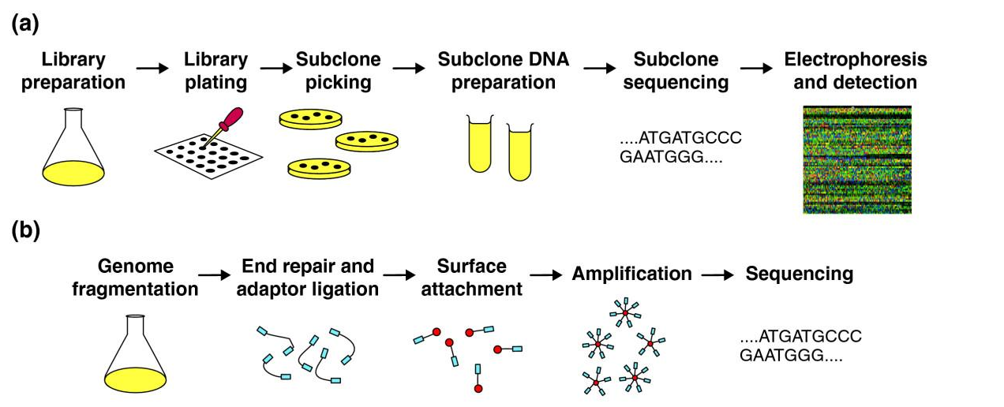
NGS has transformed biomedical inquiry
E.R. Mardis, Nature (2011) 470: 198-203, Ann. Rev. Analyt. Chem. (2013)

Slide 4
Next Generation Sequencing: the basics
NGS library construction combines DNA or RNA fragments with custom synthetic DNA adapters by ligation or transposon insertion
The resulting library fragments are amplified on a solid support (either a bead, flat surface or nanowell-covered surface) with covalently attached adapters complimentary to the library adapters
Sequencing reactions couple nucleotide incorporation and detection in a step-wise fashion, detecting hundreds of millions to billions of sequencing reactions per instrument run = “massively parallel sequencing”
Shorter read lengths than capillary sequencers = requires specialized bioinformatics-based analyses

Slide 5
Input DNA for NGS Libraries
Generally speaking, NGS sequencing libraries are ‘short insert’, with fragment sizes ranging from ~200-600 bp
Starting material for NGS libraries may be derived from numerous different sources, including:
- high molecular weight genomic DNA (cell lines, blood, fresh or frozen tissue, buccal swab/cheek scrape)
- PCR products, including from multiplex PCR
- low molecular weight/degraded DNA (formalin-fixed paraffin-embedded (FFPE) tissues, forensic specimens, Neanderthal bones)
So, the first consideration is the method of DNA isolation needed, and then evaluating the quality/intactness and yield of DNA that results

Slide 6
Evaluating Input DNA Quality and Quantity
DNA Quality/Intactness:
- cheapest = agarose gel and ethidium staining
- easiest = precast gel (Flash)
- large sample numbers: Agilent BioAnalyzer or TapeStation
DNA Quantity:
- NanoDrop (with caveats)
- Qubit
- PicoGreen + 96 well plate reader
If high mw and concentration, fragmentation is next
If low mw and concentration, challenges and adjustments will be required!

Slide 7
Fragmenting High MW Genomic DNA
Mechanical methods:
- syringe/needle high pressure shearing device
- HydroShear device
- Covaris ultrasonicator or G-tube device
Enzymatic methods:
- restriction enzyme(s) cleavage
- Zinc treatment
- proprietary nuclease cocktail / “fragmentase”
Initially, evaluate one or more post-shearing samples on gel for size range optimization

Slide 8
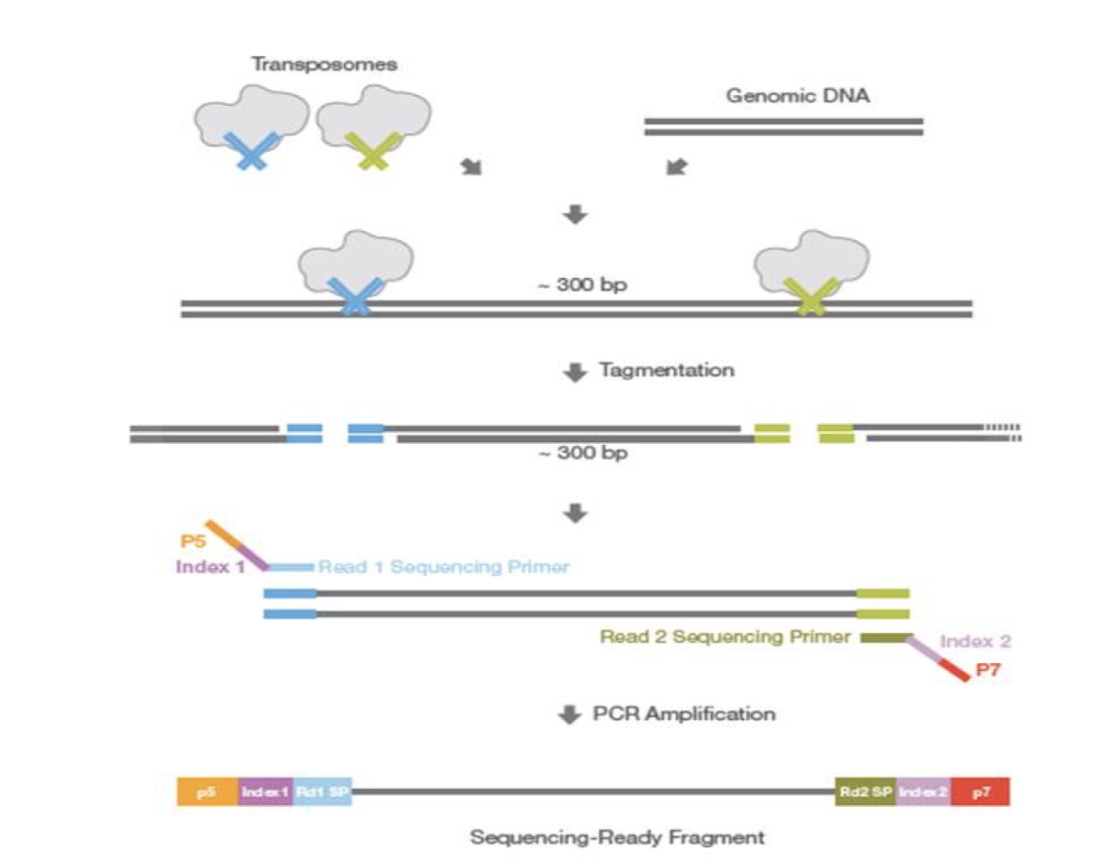
Transposon-based Library Construction

Slide 9
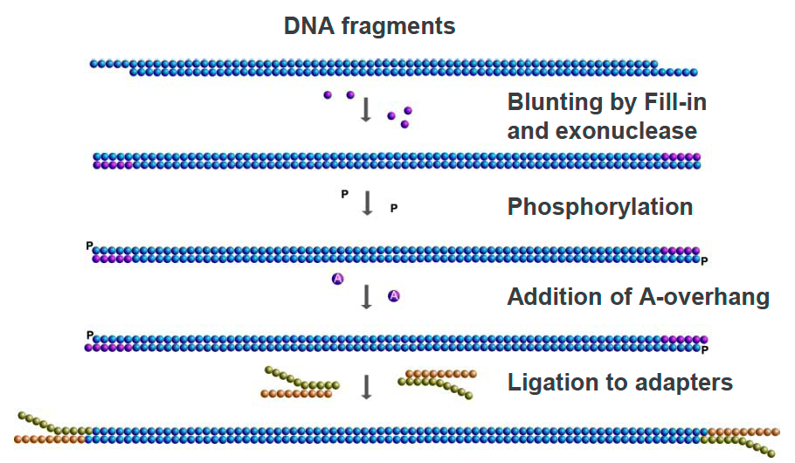
Adapter Ligation-based Library Construction
Shear or enzymatically treat high molecular weight DNA to fragment, OR derive DNA fragments from other preparatory methods
Enzymatic treatments to blunt ends
Ligate synthetic DNA adapters (with indexes), PCR amplify
Quantitate library
Proceed to WGS, or isolate exome or specific panel by hybrid capture

Slide 10
PCR-related Problems in NGS
PCR is an effective vehicle for amplifying DNA, however…
In NGS library construction, PCR can introduce preferential amplification (“jackpotting”) of certain fragments
Duplicate reads with exact start/stop alignments
Need to “de-duplicate” after alignment and keep only one pair
Low input DNA amounts favor jackpotting due to lack of complexity in the fragment population
PCR also introduces false positive artifacts due to substitution errors by the polymerase
If substitution occurs in early PCR cycles, error appears as a true variant
If substitution occurs in later cycles, error typically is drowned out by correctly copied fragments in the cluster
Cluster formation is a type of PCR (“bridge amplification”)
Introduces bias in amplifying high and low G+C fragments
Reduced coverage at these loci is a result

Slide 11
NGS Library Multiplexing and Molecular Barcoding
As throughput on NGS sequencers has increased, the ability to pool libraries or reaction products together is needed
DNA barcoding schemes permit the addition of specific sequences to each library, enabling equimolar pooling (“multiplexing”)
Post-run de-multiplexing is accomplished by software that bins reads sharing the same barcodes or barcode combinations
As sequencing costs permit deeper sequencing of libraries, the use of unique molecular identifiers (UMIs) has become necessary to separate true mutations from sequencing “noise” during data analysis

Slide 12
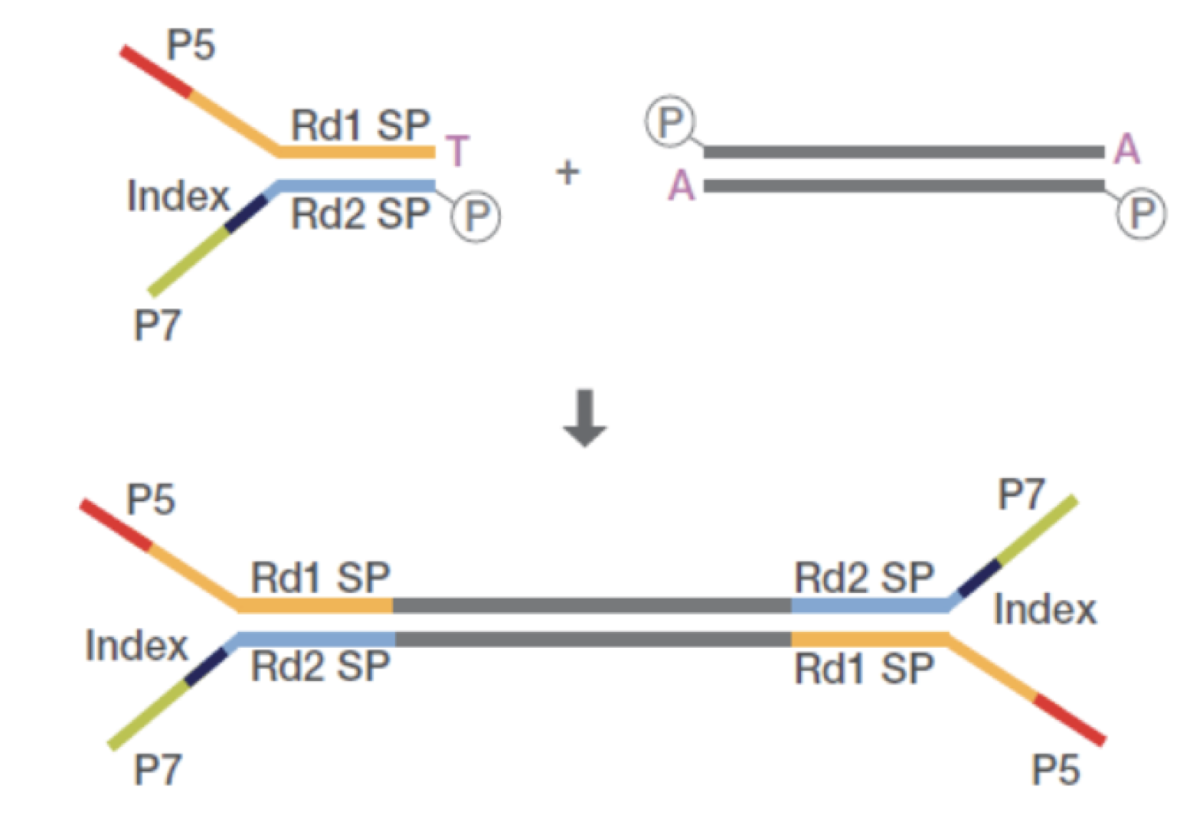
Unique Molecular Identifiers: UMI Barcoding
UMI in i7 arm of adapter is
added during ligation
Ligation product with i7 UMI

Slide 13
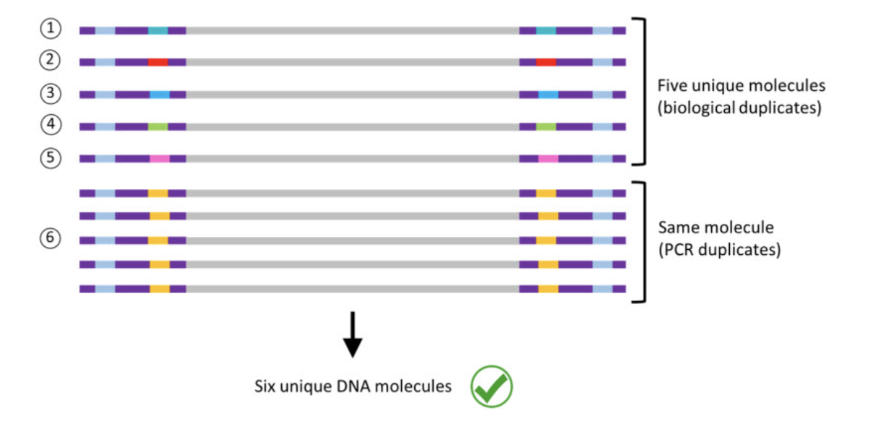
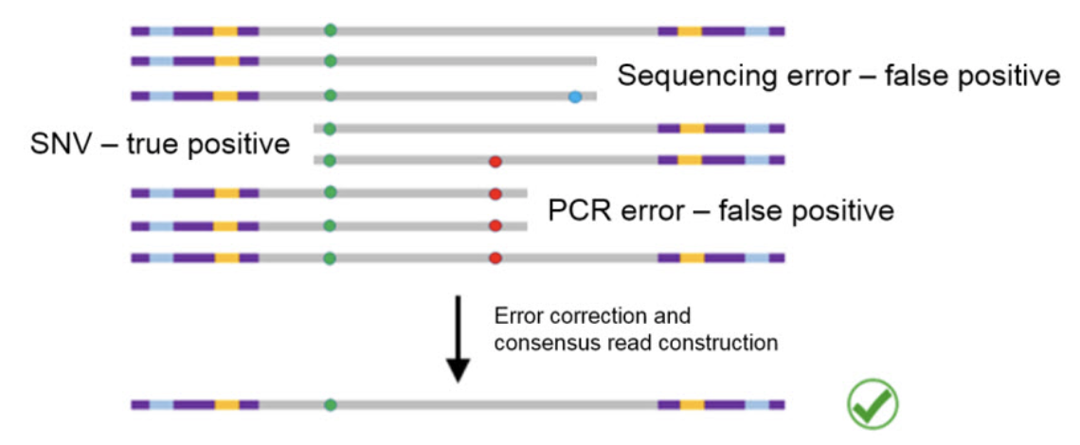
Dual Functionality of UMIs
De-duplication
Polymerase or base-calling error elimination

Slide 14
Illumina Sequencing Basics
Sequencing by Synthesis

Slide 15
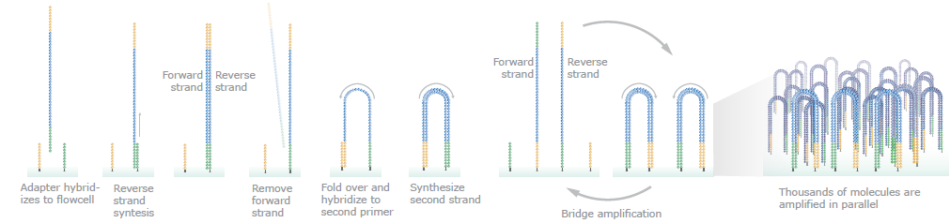
Cluster Amplification on FlowCell
Quantitating library fragments is an essential first step to cluster formation
Diluted library fragments are introduced to flow cell, and are amplified in situ using the covalently attached complementary adapter sequences
Cluster amplification is required to produce sufficient signal for detecting the sequencing reaction results at each nucleotide addition step = each cluster is derived from a single library fragment

Slide 16
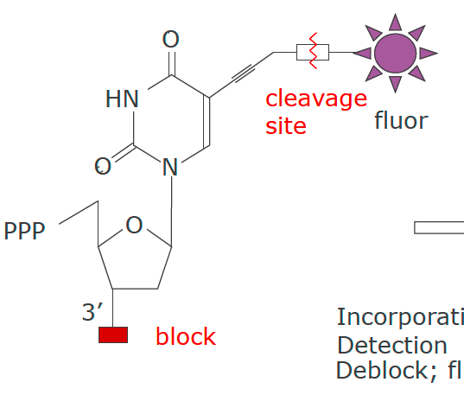
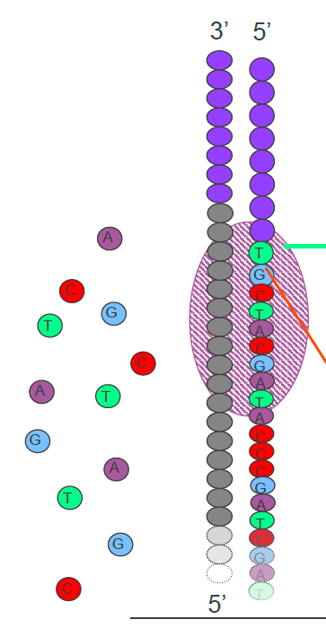
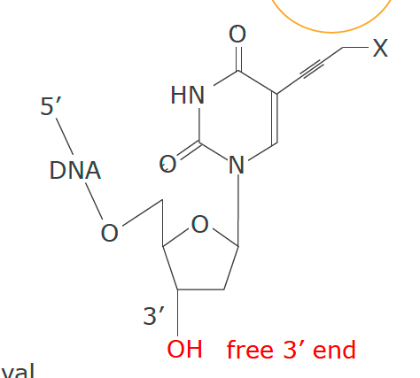
Sequencing Chemistry for SBS
Emission
Incorporate
Detect
De-block
Cleave fluor
Excitation

Slide 17
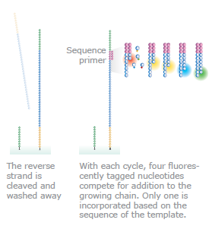
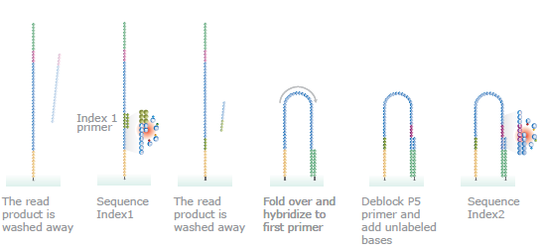
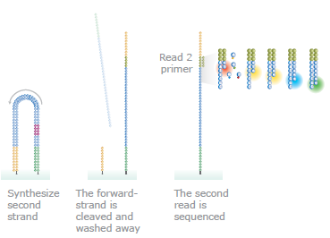
Sequencing by Synthesis

Slide 18
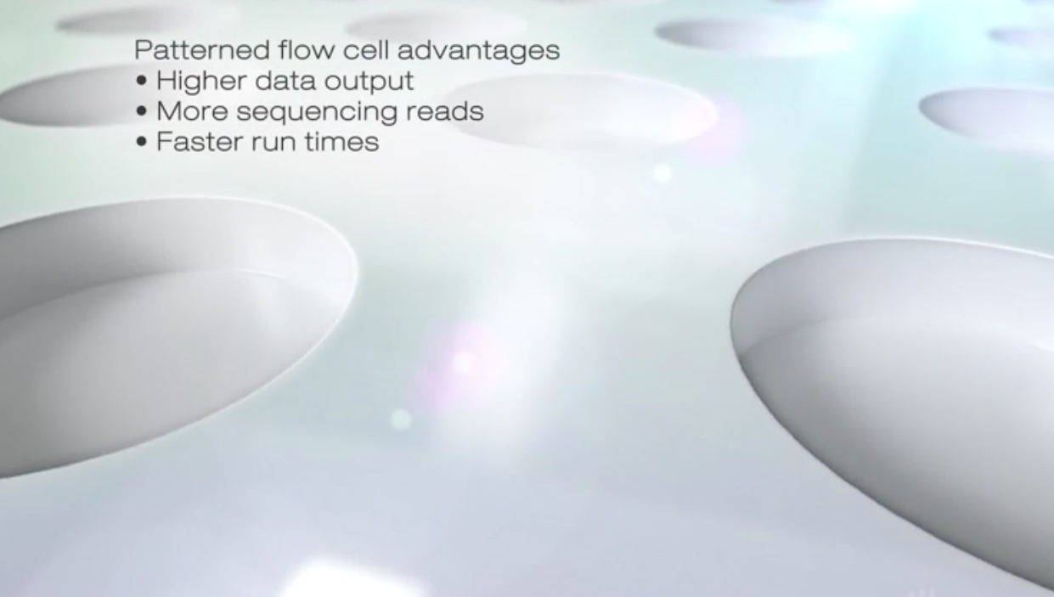
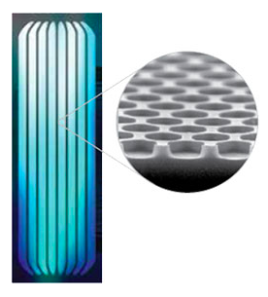
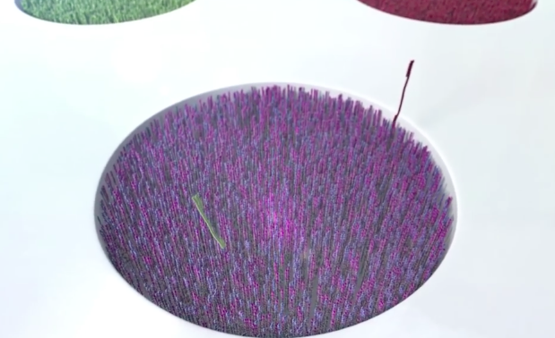
Patterned Flow Cell

Slide 19
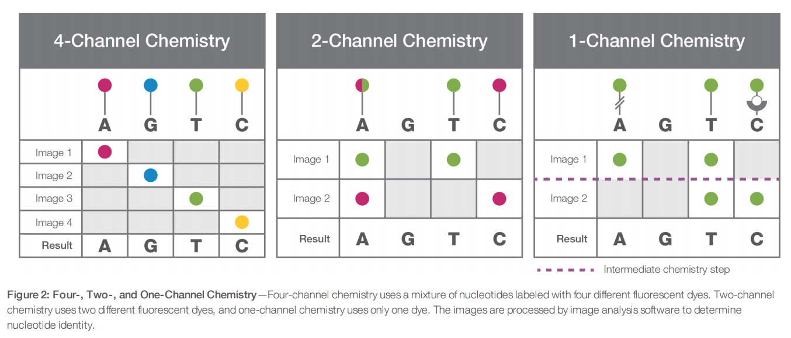
Four-, Two- and One-Color Chemistry
The MiSeq and HiSeq Series Systems currently use four-channel SBS.
The MiniSeq, NextSeq, and NovaSeq Systems use two-channel chemistry.
The iSeq 100 use one-channel chemistry.

Slide 20
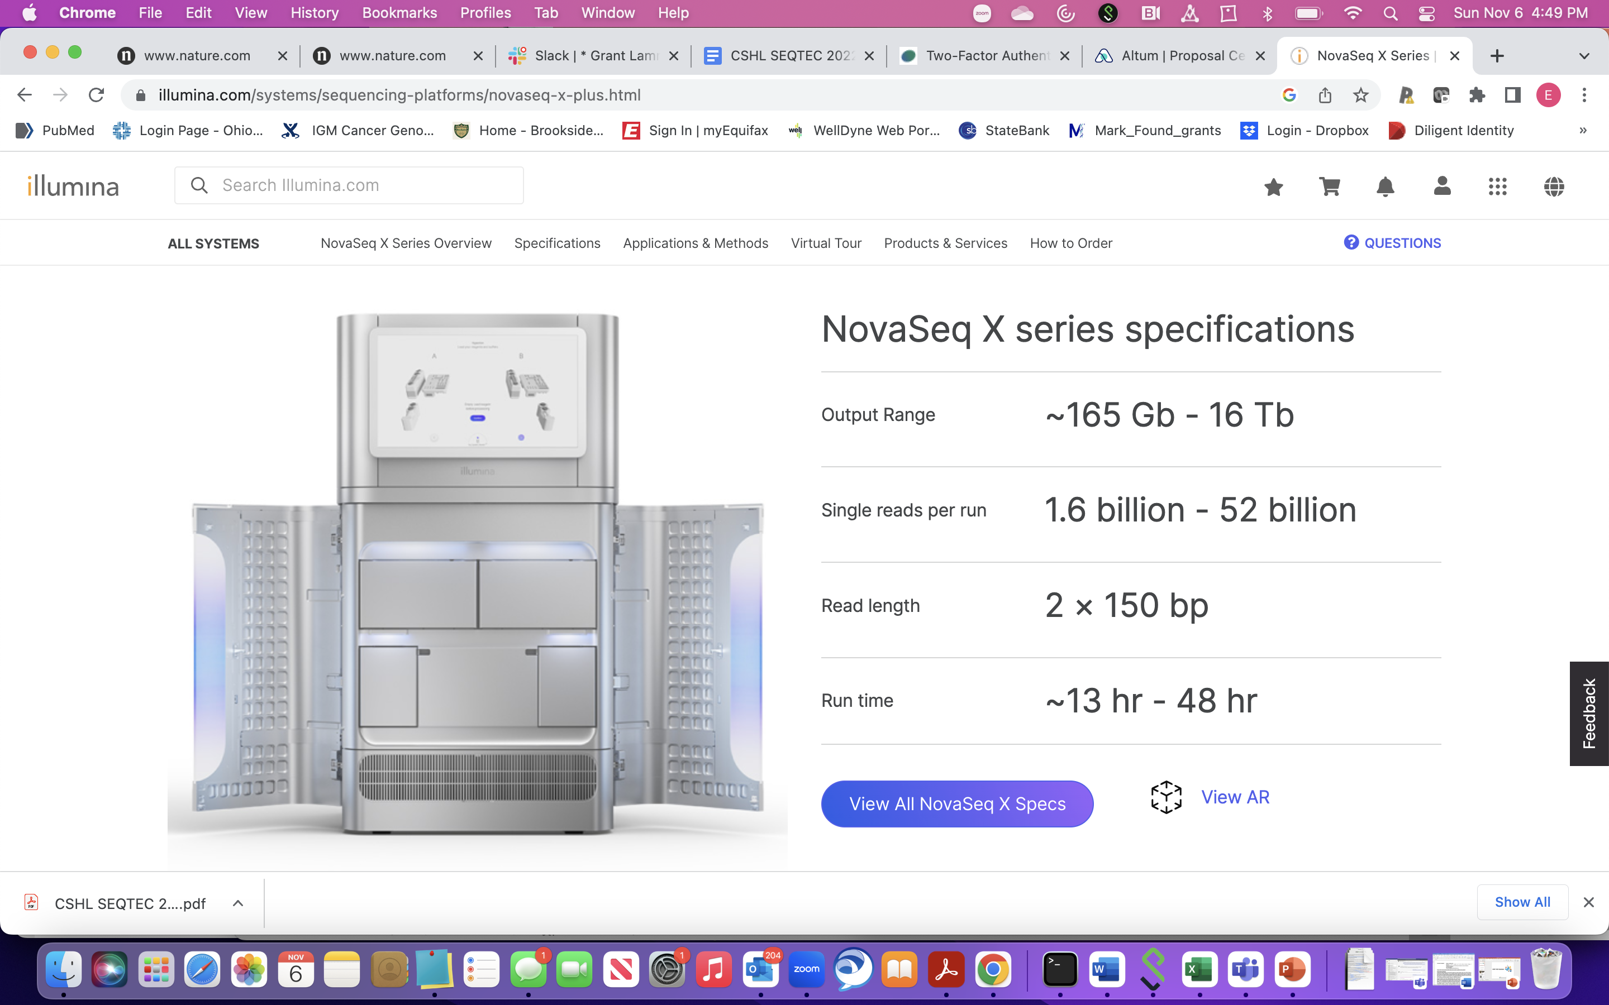
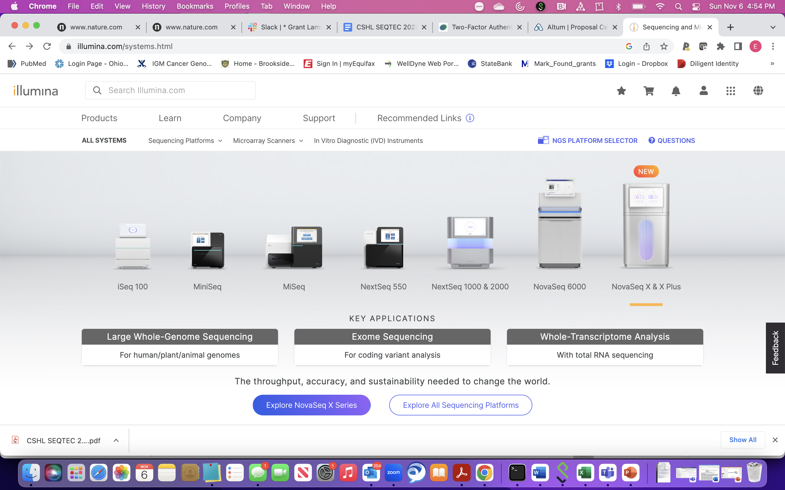
Illumina Platforms
High accuracy reads, paired end reads, range of capacity and throughput
Longer read lengths on some platforms (MiSeq)
Largest user base with accompanying software applications, Dragen rapid alignment/analysis

Slide 21
Ion Torrent Sequencing Technology
Sequencing by pH Sensing

Slide 22
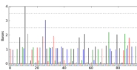
pH Sensing of Base Incorporation
On-bead fragment amplification by emulsion PCR
Unlabeled native dNTPs
Undefined read lengths

Slide 23
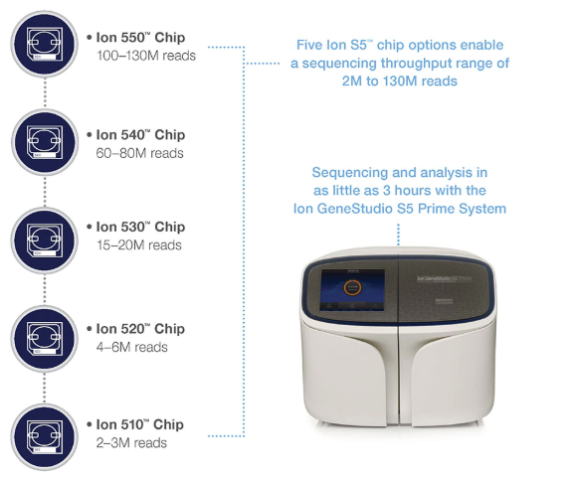
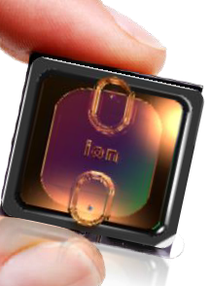
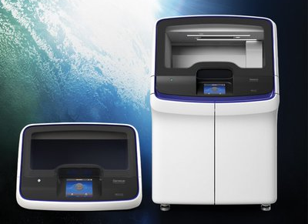
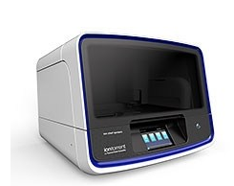
Platforms
Ion Torrent S5
Ion Chef
IonTorrent Genexus
Low substitution error rate, in/dels problematic, single end reads
Inexpensive and fast turn-around for data production
Clinical platform (Genexus)
Microbiome, immune gene sequencing applications

Slide 24
Sub-setting the Genome for NGS-based Assays
Exome and Gene Panels

Slide 25
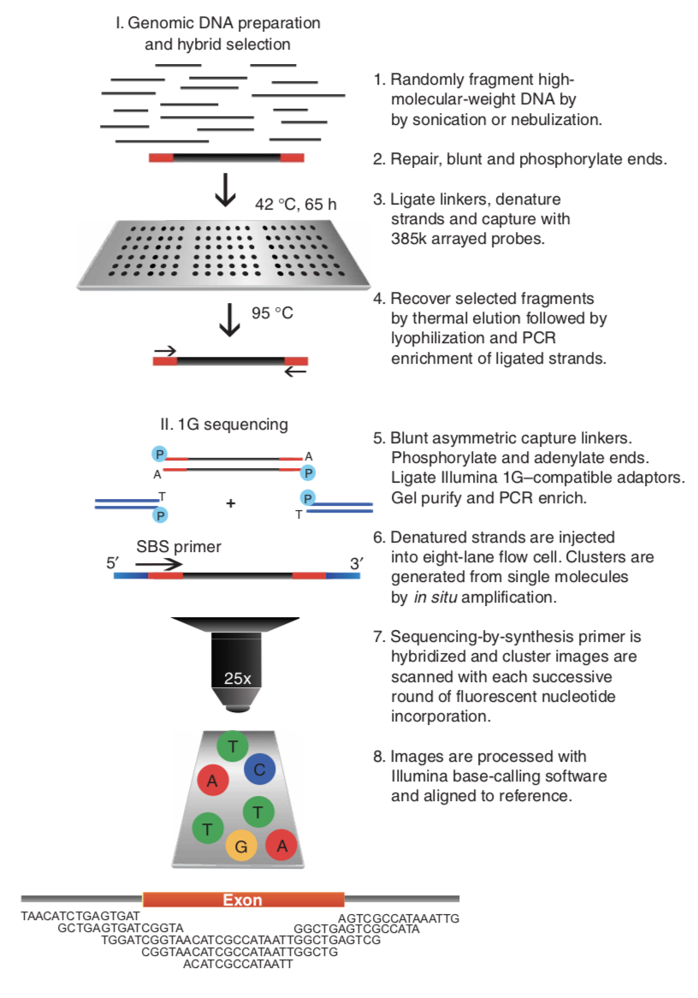

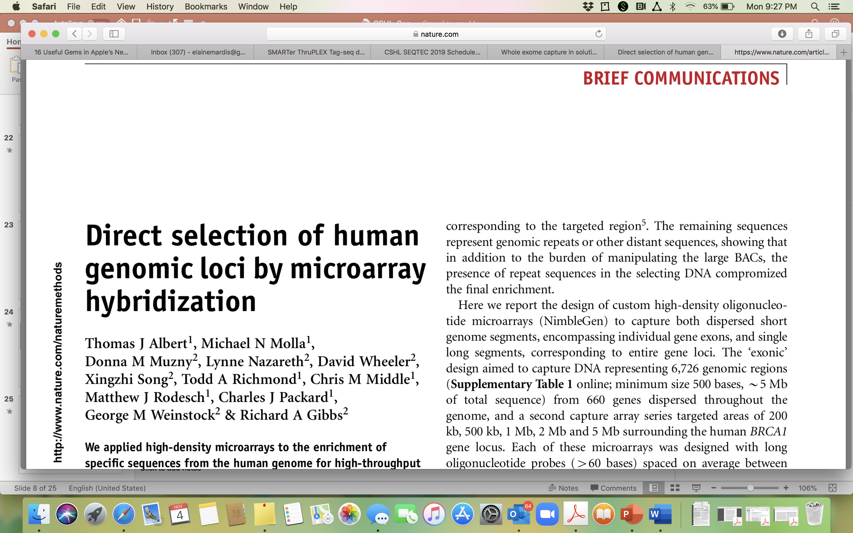
Direct Genomic Selection

Slide 26
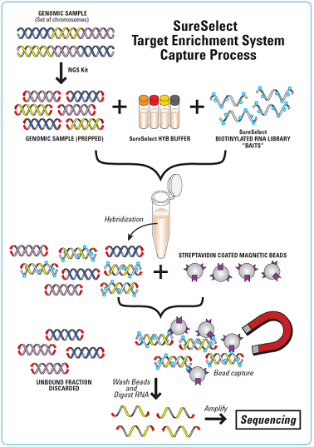
Solution-Phase Hybrid Capture
Hybrid capture - specific sequences from a whole genome library are selected by hybridization to probes that correspond to human exons or gene panels.
Probe DNAs are biotinylated, so hybrids can be removed from solution with streptavidin magnetic beads.
An “exome” by definition, is captured with probes corresponding to the exons of all genes annotated in the reference genome.
Custom capture reagents or “gene panels” can be synthesized to target specific loci that may be of clinical interest.

Slide 27
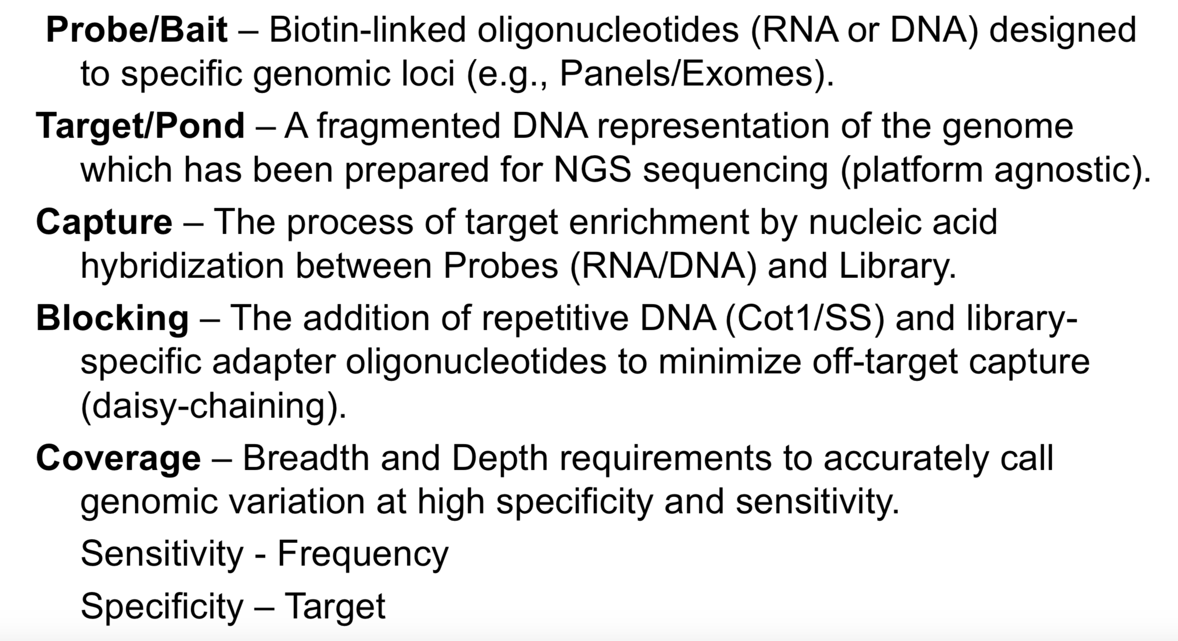
Hybrid Capture Terminology
Notes:
BED File!!

Slide 28
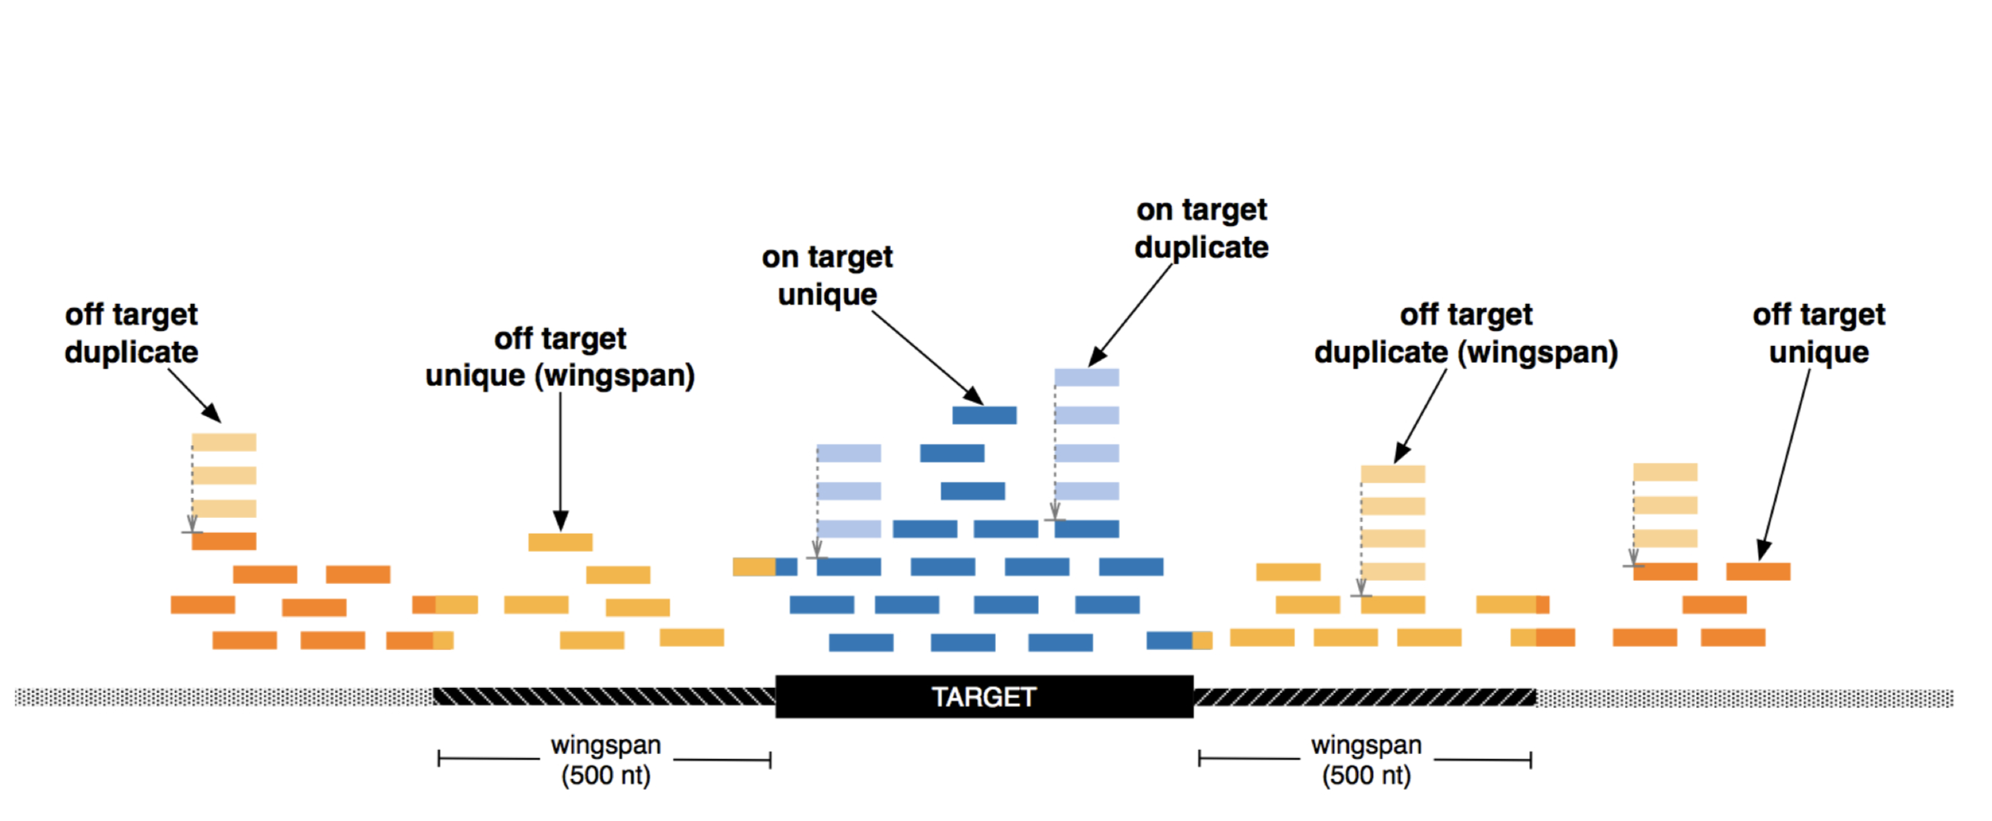
Coverage Definitions for Hybrid Capture

Slide 29
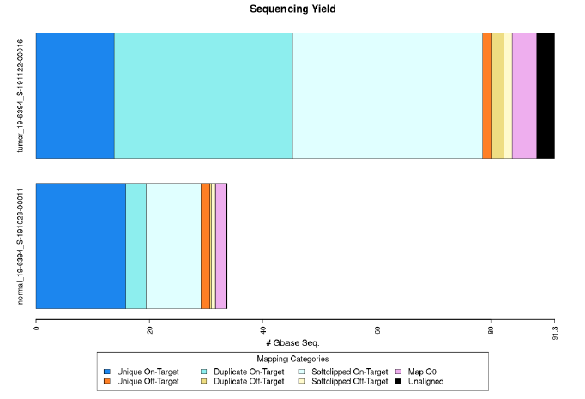
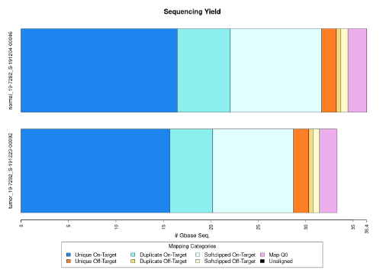
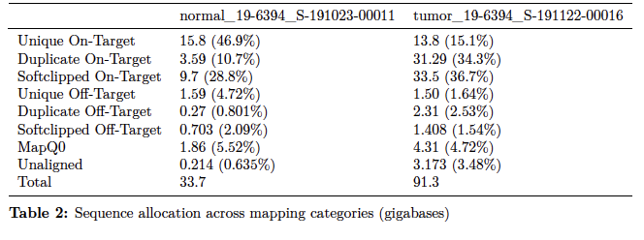
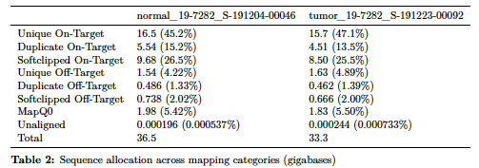
Evaluating Coverage Post-Alignment and De-dup

Slide 30
Evaluating Probe Coverage Breadth at Fixed Depth

Slide 31
Probe Coverage and Outlier Analysis

Slide 32
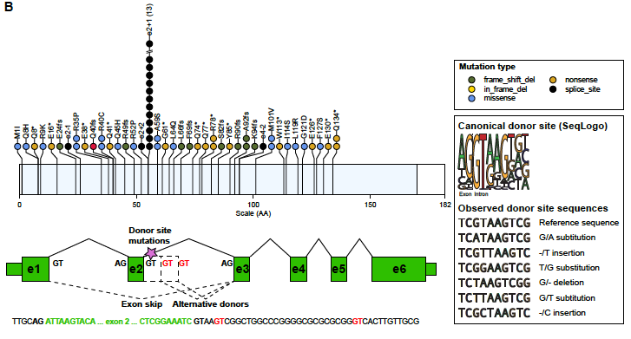
Hybrid Probe Placement Matters: Missed Splice Site Mutation
O.L. Griffith et al., Nat. Commun. 2018

Slide 33
Data visualization
Examining NGS data

Slide 34
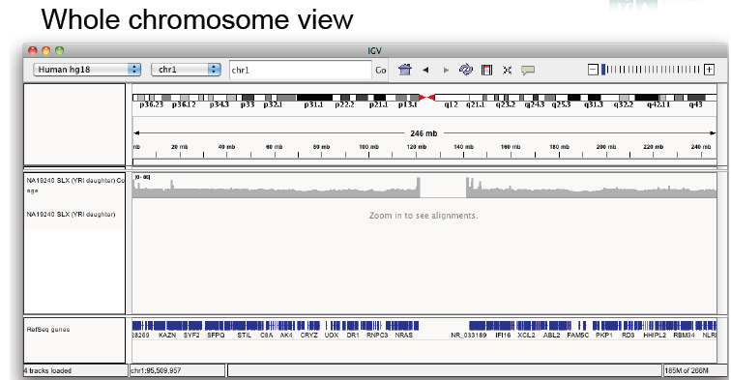
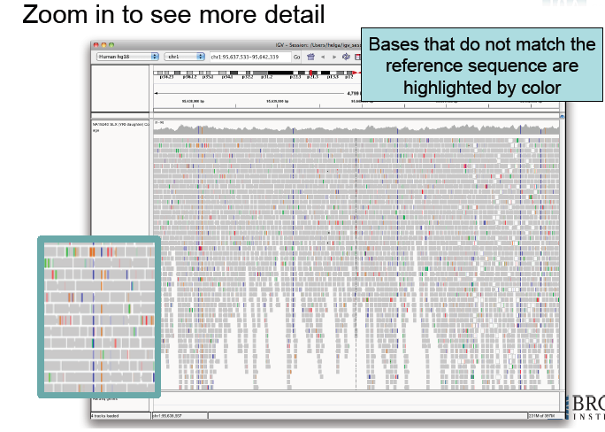
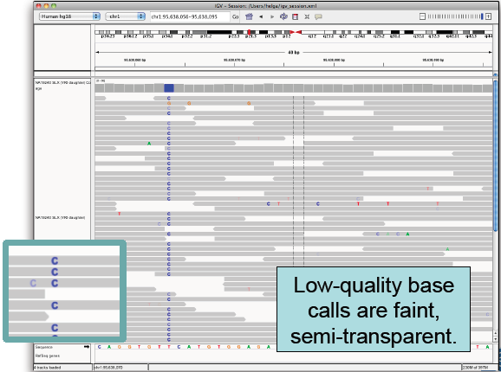
Integrated Genomics Viewer (IGV)
http://www.broadinstitute.org/igv

Slide 35
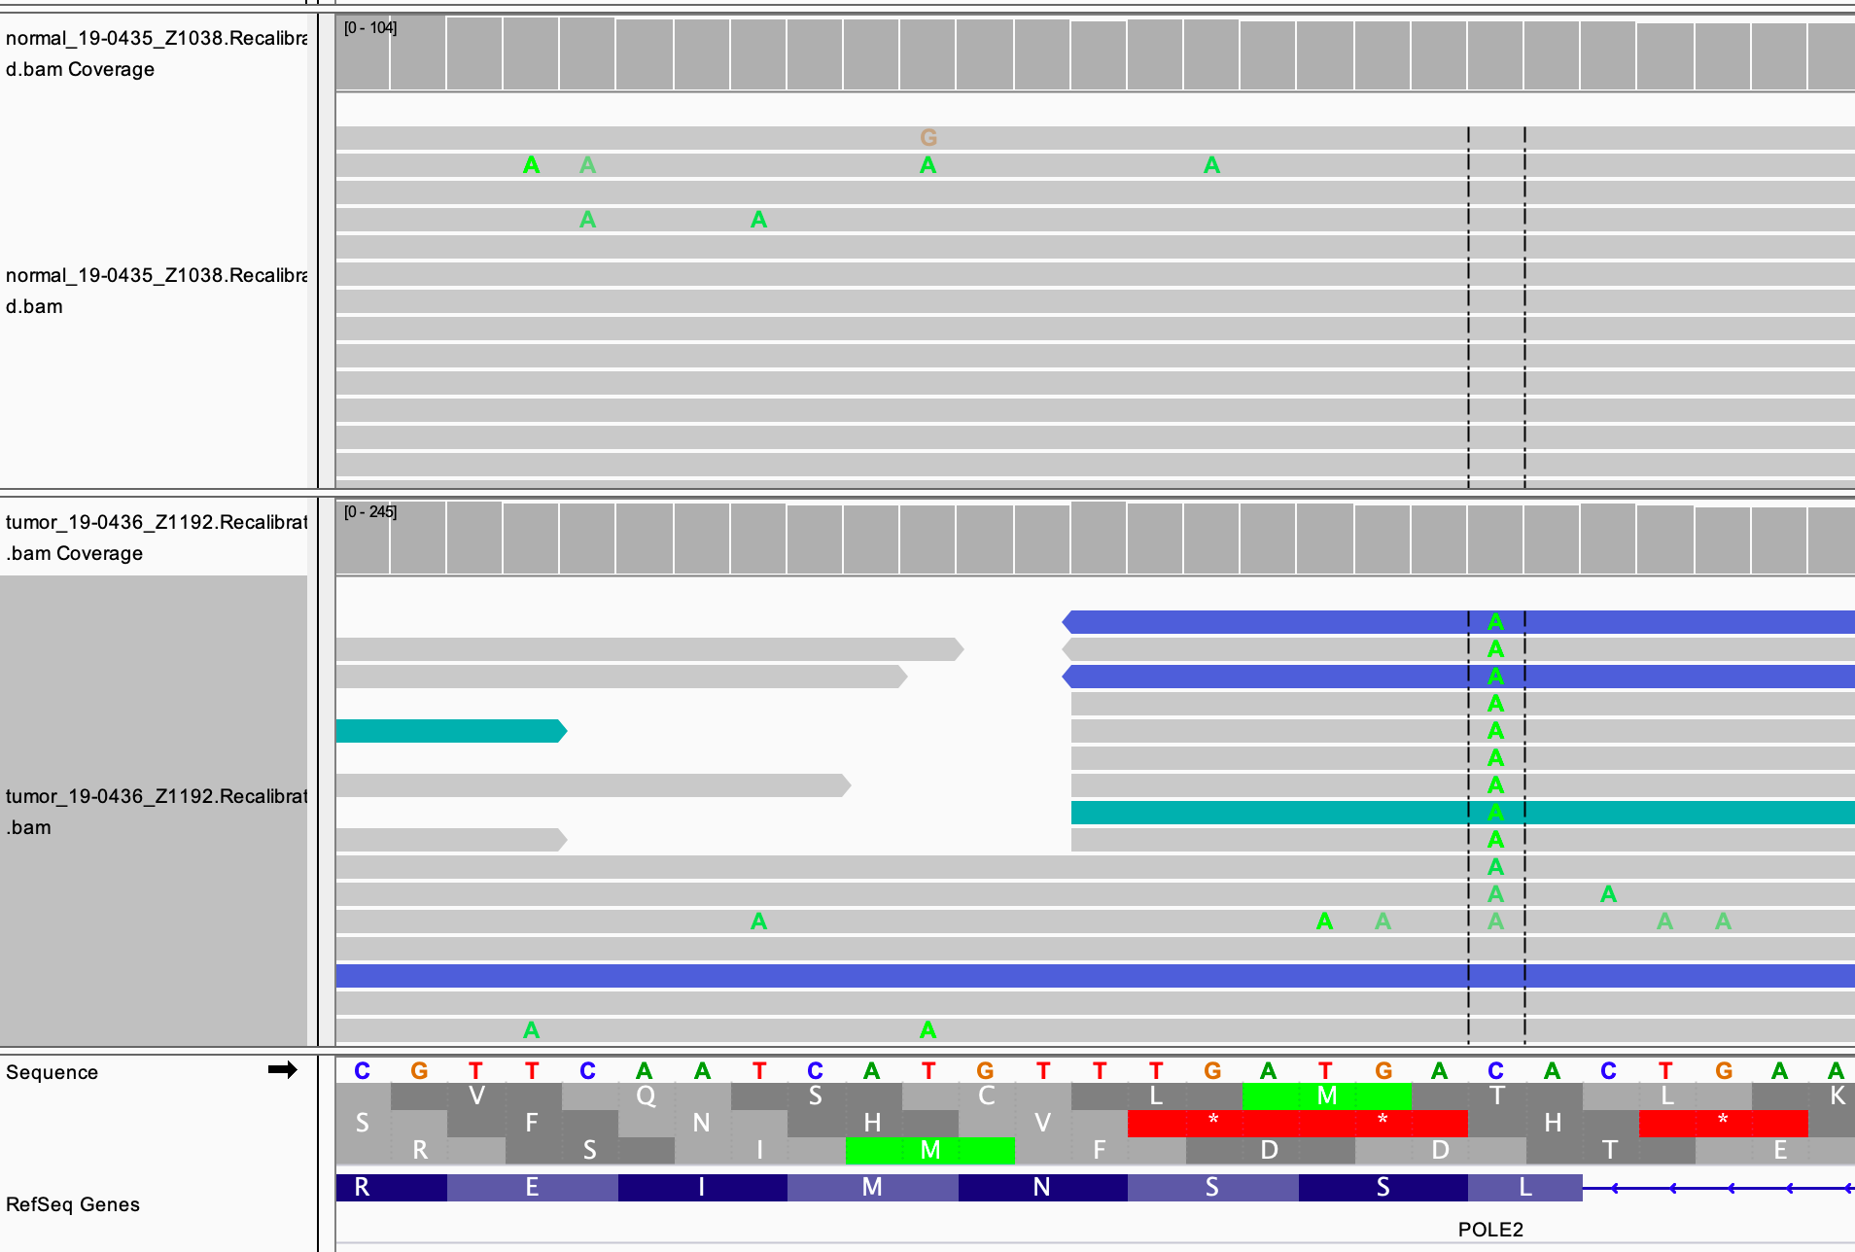
IGV Visualization of Tumor vs. Normal : Somatic SNV

Slide 36
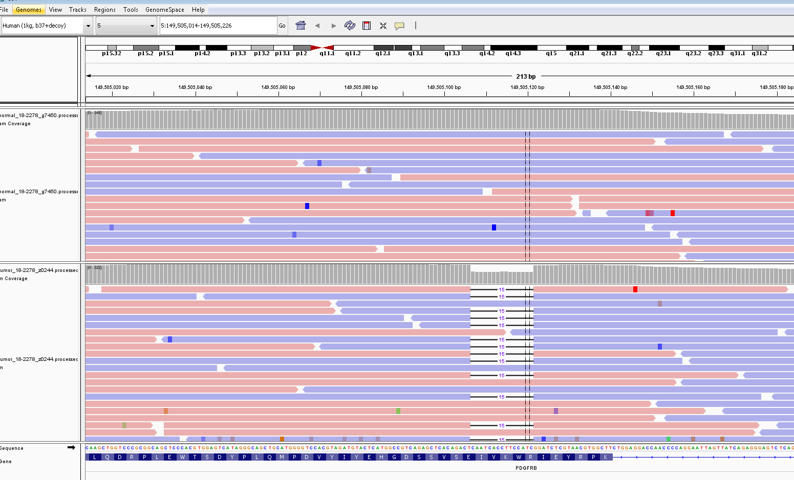
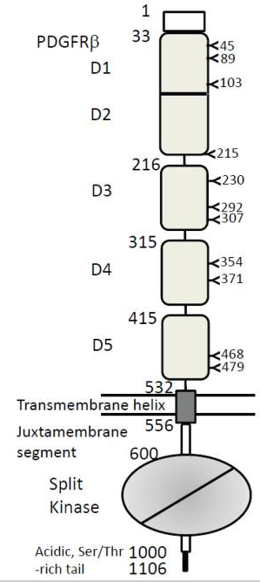
IGV: Somatic Insertion/Deletion

Slide 37
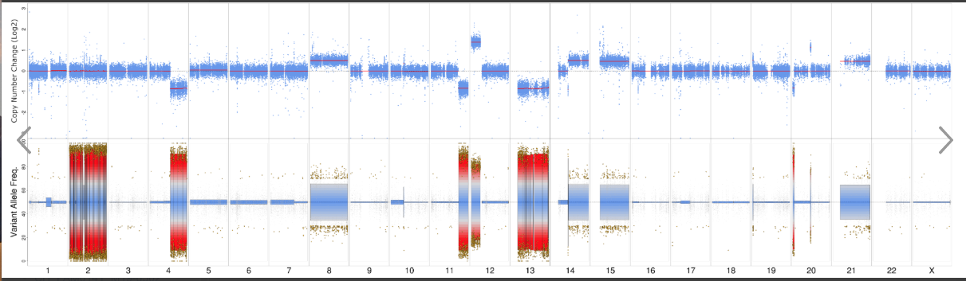
Copy Number Alterations Genome-wide

Slide 38
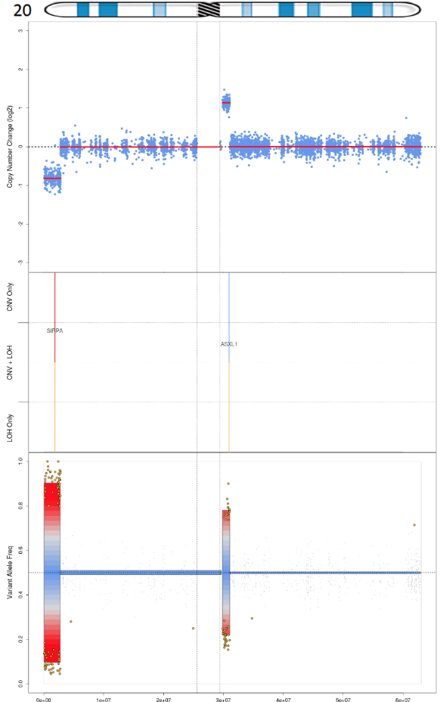
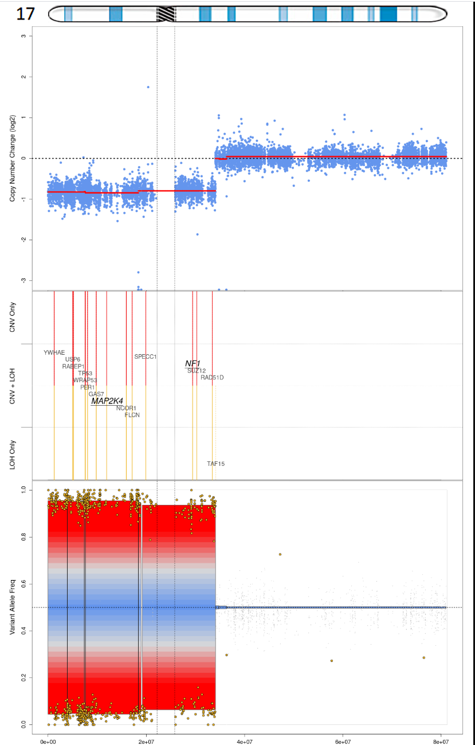
Copy Number Alterations: Arm-level and Focal

Slide 39
RNAseq

Slide 40
RNAseq: Why
Increasing emphasis on sequencing the transcriptome, combined with multiple types of computational analysis
Fusion detection, exon skipping, allele-specific silencing, epigenetic links to driver gene amplification, immune deconvolution (in cancer)
Multiple sizes of RNAs are being identified and linked causally to disease and other mechanisms of gene regulation (miRNAs, lncRNAs)
Analysis identifies differential gene expression, alternative splicing, RNA editing
Provides a gene set for organisms without a reference genome

Slide 41
RNAseq “Gotchas”
RNA is sensitive to degradation from heat and FFPE treatment
Genomic DNA can co-isolate with RNA and cause multiple problems
Isolating mRNA decreases the total amount of RNA into library prep
Strandedness is important
Short reads make detecting certain RNA-specific attributes or aberrations difficult (exon skipping, etc.)

Slide 42
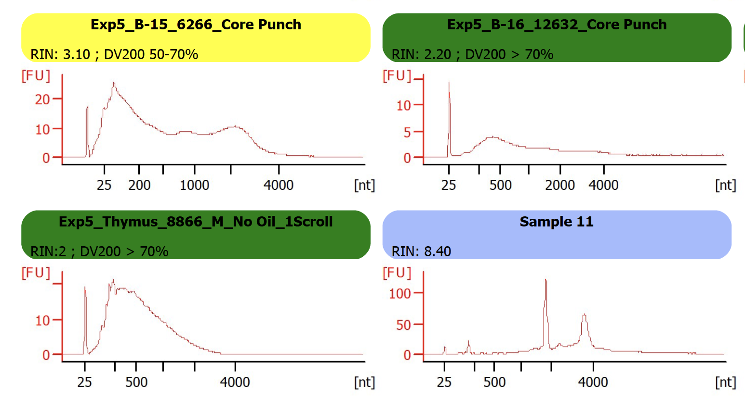
QC of RNA is Essential

Slide 43
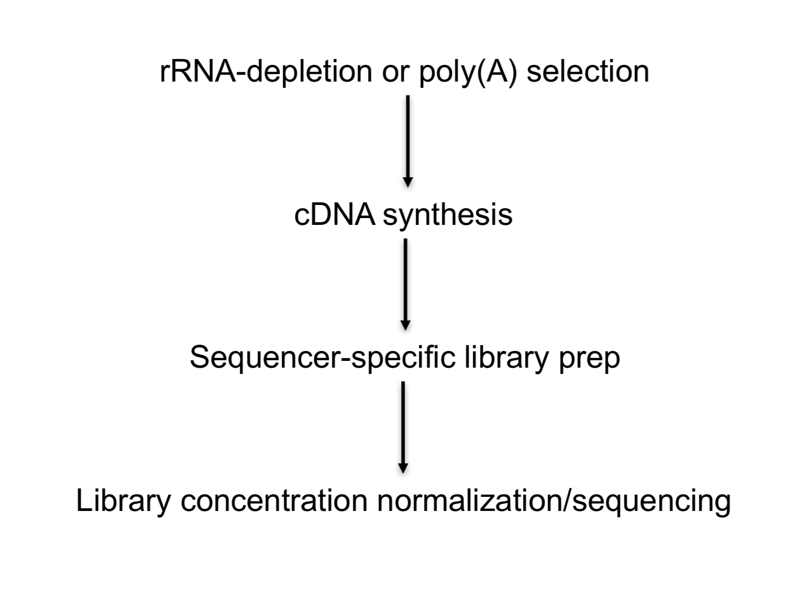
RNAseq Overview

Slide 44
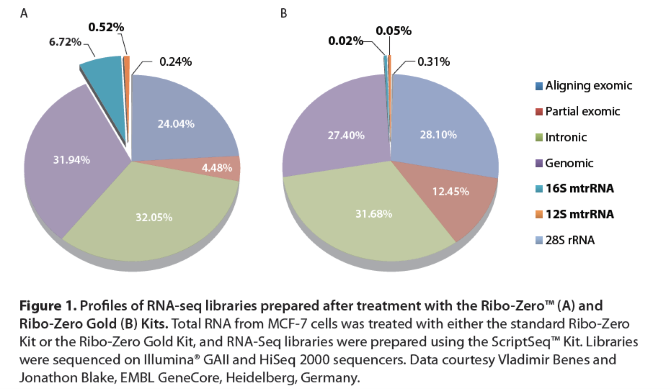
rRNA Depletion using RiboZero Reagent

Slide 45
NEBNext Ultra II Directional
Total RNA
(100 ng – 1 µg)
Anneal to DNA probes
Digest DNA/RNA hybrid with RNase H
Digest DNA probes with DNase
rRNA depletion
SPRIselect purification
RNA fragmentation
First-strand cDNA synthesis
Second-strand cDNA synthesis
SPRIselect purification
End Prep
Repair DNA ends
3’ adenylation
Adapter ligation
(IDT xGen Dual Index UMI Adapters)
SPRIselect purification
qPCR cycle
optimization
Hybrid Capture
IDT xGen Lockdown Probes
Enrichment PCR
SPRIselect purification
Library QC
Qubit DNA Concentration
Bioanalyzer/TapeStation visualization
KAPA Library Quant qPCR

Slide 46
RNA “stranded” Sequencing

Slide 47
Conclusions
Widespread use of NGS platforms for biological research has changed the scale of biomedical inquiry and discovery
A variety of platforms and approaches are available for implementation of NGS, each with strengths and weaknesses.
Due to the size and complexity of the resulting data sets, validated approaches to assure quality of the data, along with analytical pipelines having appropriate sensitivity, specificity and reproducibility are required.
Similarly, data visualization interfaces are needed to permit genome-wide and locus-specific evaluation of variants and underlying data support.

